Slide 1
Linux Lineage and the Cast of Characters
How BSD Happened
In 1976-77, Ken Thompson took a six-month sabbatical from Bell Labs to teach as a visiting professor at the Computer Science Department at the University of California-Berkeley (UCB). What he taught, of course, was the UNIX system. While there, he also developed much of what eventually became Version 6.
Cultural note: Co-creator of the Unix operating system, he graduated from Berkeley in 1966 with a degree in electrical engineering. He returned to the university from Bell Labs for a sabbatical in 1975. But the campus on which he had once walked to class through clouds of tear gas had changed. That year, says Thompson, Berkeley “had turned into the most politically apathetic place I’d seen.”
CS-334 Spring 2015 Page <number> of

Slide 2
When Thompson returned to Bell Labs, students and professors at Berkeley continued to enhance UNIX. Eventually, many of these enhancements were incorporated into what became known as Berkeley Software Distribution (BSD) Version 4.2, which many other universities also bought.
Linux Lineage and the Cast of Characters
CS-334 Spring 2015 Page <number> of

Slide 3
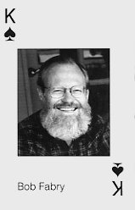
Linux Lineage and the Cast of Characters
Berkley's Bob Fabry sets up an organization which was christened the Computer Systems Research Group, or CSRG for short. Fabry turned his attention to finding a project leader to manage the software development. Fabry enlisted Bill Joy, who had just passed his PhD qualifying exam.
Why the playing card?
CS-334 Spring 2015 Page <number> of

Slide 4
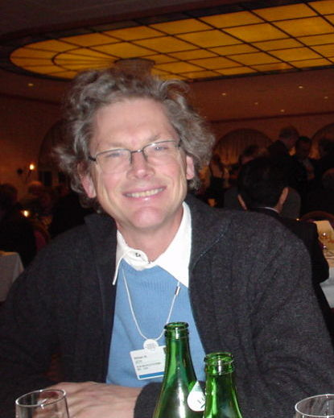
Linux Lineage and the Cast of Characters
Who’s this?
CS-334 Spring 2015 Page <number> of

Slide 5
Linux Lineage and the Cast of Characters
Bill Joy
Current net worth: $1.5 billion
CS-334 Spring 2015 Page <number> of

Slide 6
Linux Lineage and the Cast of Characters
Joy chose to attend UC-Berkeley instead of Stanford or MIT not because he was attracted by its politics or counter-cultural reputation but because the computer science department’s hardware was so obsolete that he figured he’d have no choice but to confine his research efforts to studying computing theory
CS-334 Spring 2015 Page <number> of

Slide 7
Linux Lineage and the Cast of Characters
...Like so many great hackers, Joy is also almost unconsciously arrogant. And that arrogance has been, historically, a key part of the BSD legend. As a general rule, programmers tend to have a high opinion of themselves. And as a class, Unix programmers are well known for demonstrating their own special blend of high-priest orneriness.
- A. Leonard at Salon.com
CS-334 Spring 2015 Page <number> of

Slide 8
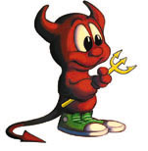
Another BSD Contribution -
Linux Lineage and the Cast of Characters
CS-334 Spring 2015 Page <number> of

Slide 9
Another BSD Contribution -
Linux Lineage and the Cast of Characters
“Beastie”
CS-334 Spring 2015 Page <number> of

Slide 10
Linux Lineage and the Cast of Characters
“Berkeley’s most important contribution was not software; it was the way Berkeley created software. At Berkeley, a small core group — never more than four people at any one time — coordinated the contributions of an ever-growing network of far-flung, mostly volunteer programmers into progressive releases of steadily improving software. In so doing, they codified a template for what is now referred to as the “open-source software development methodology.” Put more simply, the Berkeley hackers set up a system for creating free software.” - Andrew Leonard, internettime.com
CS-334 Spring 2015 Page <number> of

Slide 11
Linux Lineage and the Cast of Characters
BSD itself wasn’t originally free software. Joy sold it, with the University of California’s blessing, at a nominal cost only to people or institutions that had already purchased licenses permitting them access to the source code of AT&T Unix (although, in practice, Joy’s efforts to verify whether would-be buyers really did own licenses may not have been overly vigorous). But in spirit, Berkeley Unix was indeed free: As Dennis Ritchie, Thompson’s collaborator in creating Unix, observes, anyone who wanted to hack on Unix usually had access to the source code, one way or another. And if those hackers sent their modifications to Berkeley, and they were deemed good enough, they became part of a code base maintained by programmers who wanted nothing more than for their software to be widely used, for as low a cost as possible.
- Andrew Leonard, salon.com
CS-334 Spring 2015 Page <number> of

Slide 12
Linux Lineage and the Cast of Characters
But in the early ’90s, after a bitter confrontation with AT&T, BSD finally did become “freely redistributable,” and descendants of BSD — led by FreeBSD,* but also including OpenBSD* and NetBSD* — are vigorous participants in the contemporary battle for operating-system supremacy. Yahoo, arguably the world’s busiest Web site, runs on FreeBSD (May, 2000).
CS-334 Spring 2015 Page <number> of

Slide 13
Linux Lineage and the Cast of Characters
The Divorce ~1992
ATT licensing of Sys V had gone from $99 to $250,000.00
ATT sued Berkeley
Wait - Sys V contained Berkeley code –
users could do anything they wanted with BSD code as long as they retained the University of California copyright. But AT&T had stripped the UC copyrights and begun marketing the software as its own (no wonder Stallman has attitude)
CS-334 Spring 2015 Page <number> of

Slide 14
Linux Lineage and the Cast of Characters
UCB counter-sued, and a settlement was reached
Terms:
  4.4BSD-lite to be released containing no disputed files. University to encourage licensees to switch from Net-2.
  University to cease distribution of certain files.
  USL to grant three months' grace period to users of disputed files.
  Certain files distributed by University to carry USL copyright notice.
  Certain files distributed by USL to carry University copyright notices.
  USL to permit free distribution of certain files.
  University not to actively assist in legal attempts to challenge USL's rights to certain files.
CS-334 Spring 2015 Page <number> of

Slide 15
Linux Lineage and the Cast of Characters
Berkeley today
BSD Committers list
About BSD
CS-334 Spring 2015 Page <number> of

Slide 16
Linux Lineage and the Cast of Characters
BSD Licensing
BSD License Template
Open Source Definition
CS-334 Spring 20145 Page <number> of

Slide 17
Linux Lineage and the Cast of Characters
That brings us to Linux
CS-334 Spring 2015 Page <number> of

Slide 18
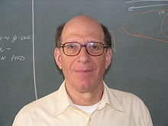
Linux Lineage and the Cast of Characters
Well, almost...
Tanenbaum and MINIX (1987)
...not free
Minix created for use with his OS textbook
Used by Torvalds to create his kernel
Dr. Andrew S. Tanenbaum
CS-334 Spring 2015 Page <number> of

Slide 19
Linux Lineage and the Cast of Characters
1991 – Torvalds began work on what would become the Linux kernel
1992 – Linux kernel released under GNU GPL
CS-334 Spring 2015 Page <number> of

Slide 20
Linux Lineage and the Cast of Characters
Debian
Ubuntu - based on Debian sid
“sid” == “unstable”
See http://www.wikivs.com/wiki/Debian_vs_Ubuntu
Mint
(.deb)
1993
Sept 2004
CS-334 Spring 2015 Page <number> of

Slide 21
Linux Lineage and the Cast of Characters
RedHat
Fedora CentOS
SUSE
(.rpm)
CS-334 Spring 2015 Page <number> of

Slide 22
Linux Lineage and the Cast of Characters
Mandrake
Mandriva
Mageia
(RedHat)
1998
2010
CS-334 Spring 2015 Page <number> of

Slide 23
Linux Lineage and the Cast of Characters
ATT System V
FreeBSD
PC-BSD GhostBSD Open BSD NetBSD Dragonfly
CS-334 Spring 2015 Page <number> of

Slide 24
Linux Lineage and the Cast of Characters
Slackware
SuSE
YaST
Novell
1992
1996
2003
2005
CS-334 Spring 2015 Page <number> of

Slide 25
Linux Lineage and the Cast of Characters
Does that cover all of them?
Most of them?
At last count – 767
Linux light?
lubuntu
Don't install it! Run as a live CD!!! Always have a current backup and windows rescue CD set when installing operating systems!
CS-334 Spring 2015 Lecture 2 Page <number> of

